Slide 1
Year 11 Information Evening

Slide 2
Presentations
Mr Niland – Assistant Principal – Exams
Mr Rogers – Director of Global Studies
Miss Heritage – Director of Maths
Dr Massie – Director of English
Dr Broadhurst – Director of Science
Mr Hancock – Vice Principal – Interventions

Slide 3
Important Dates
27th February - February/March PPE begins
Week ending 22nd March – Final report out to parents
9th May – GCSE exams begin
24th May – Last day that students must attend school
22nd August – GCSE Results and 6th Form Admission day

Slide 4
Examinations
Examinations start on 9th May
All exams will take place in the sports hall, drama studio or smaller nearby rooms
Students need to ensure they have all necessary equipment for each exam
Attendance at all exams and punctuality is essential
School uniform must be worn for all exams
Each student will be given a personalised timetable with their room and seat number
Students will receive all the JCQ guidance that must be read before they start their exams
Access arrangements will be whatever arrangements they had in previous PPE unless students have been informed otherwise

Slide 5
Rules for the examinations

Slide 6
Rules for the examinations
https://www.youtube.com/watch?v=xLDe6JDlcjU

Slide 7
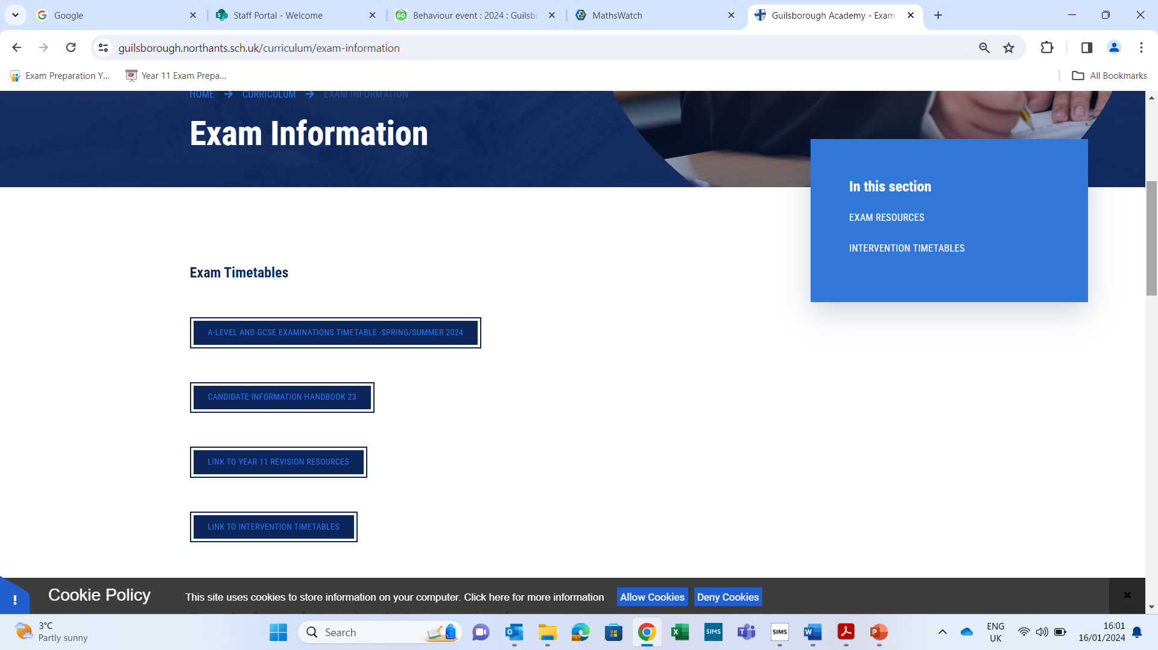
Examination Area on our website
Exam information

Slide 8
Examination Area
February/March PPE timetable
GCSE summer timetable
Candidate information handbook
JCQ notices
Intervention timetables
Exam revision resources
All other information will be added to this area as the year progresses

Slide 9
Contingency Dates
All students must be available to sit exams from the date of their first exam until 26th June
6th June (afternoon only)
13th June (afternoon only)
26th June (all day)

Slide 10
Last Day
May 24th is the last day that students must attend
As this is the last day before half term and no exams take place that day students will be allowed to leave at 12.15pm with permission.
Students will have their leaving assembly, food and fun!
After half term, permission will also be needed for students to be able to leave school after an exam.
Students can remain in school on the last day or after the holiday and will be supervised in dedicated study areas
Revision sessions will continue to be run during this time

Slide 11
Results and Enrolment Day
GCSE Results and 6th Form admission day is on 22nd August
Results will be available to collect between 9.00 am and 12.00 pm
Permission in writing and photo ID will be needed if someone other than the student is collecting their results
Admission to 6th form will happen at the same time.
Our careers advisor will be present to assist any students that need help

Slide 12
Global Faculty Year 11 Support

Slide 13
History
How to revise?
10 minutes every day= pick one mini section to read from revision booklet= America,War,Medicine,Eliz
10 minutes every day =Looking over the video revision list- focus on the topics you cannot remember much
Full exam paper timed closed book – once a month
One exam Q timed each week
Exam paper and/or Yoda/Gandalf booklet Qs each week to help structure
5 minutes a day – memory help using seneca or Quizlet
What websites/resources?
BBC Bitesize
GA revision booklet & Quick revision guide
Source and Exam Q help sheets – 2 minutes each
Revision video list via staff
Mini Quiz PP on all aspects of the course via staff

Slide 14
Geography
How to revise
Revision calendar
PLC’s (personal learning checklists) RAG
Revision Clocks
Knowledge Organisers
Use your teachers to help address misconceptions
Create flashcards with key words and answers on the back – ask family to test.
Handing in extra exam practice questions
Finding past papers, markschemes and examiner reports online
Revision posters
Listen to podcasts/watch youtube clips
Making independent notes from your exercise book or revision guides
Work with a friend/study group
Create mindmaps and concept diagrams
Watch relevant documentaries, especially about case studies.
Dual coding information (diagrams, words and images of your learning)
Take regular breaks
Switch between topics and papers – Human to Physical
Timed practice writing 9 marking answers
Websites
https://senecalearning.com/en-GB/ Seneca
https://www.gcsepod.com/ GCSE Pod
https://mrshumanities.com/category/resources/geography-resources/ Mrs Humanities
https://timeforgeography.co.uk/ Time for Geography videos
https://www.coolgeography.co.uk/ Cool Geography
https://www.internetgeography.net/aqa-gcse-geography/ Internet Geography
Revision Guides
https://www.amazon.co.uk/GCSE-9-1-Geography-Revision-Guide/dp/0198423462?ref_=ast_sto_dp
https://www.cgpbooks.co.uk/secondary-books/gcse/humanities/geography/gas42-gcse-geography-aqa-complete-revision

Slide 15
Beliefs and Ethics
How to revise?
The methods below are steps that increase in detail:
Ensure you have a revision folder containing at least Revision Schedules and A3 summaries
Use the Revision Schedules for Paper 1 and Paper 2 to plan what to revise, when.
Use PowerPoint Revision Summary Diagrams for Paper 1 and Paper to remind you of the specification content for each paper
Use the A3 Topic Overviews to gain a basic understanding of each of the 8 topics.
The knowledge contained here is sufficient to achieve Grade 3 if learned well.
Use Seneca to develop knowledge of key terms and concepts
Use the Oxford Revision Guide to revise each topic.
Write bullet points summaries of keywords on a page of A4. Add detail from your exercise
Have a pen in hand. Write bullet point answers
Use OneNote Past Papers and mark schemes to apply knowledge
Plan bullet point answers to questions (closed book)
Use mark schemes to identify improvement points/missing knowledge
Use OneNote WAGOLLs to learn how to produce improved answers to different papers
Aiming Higher? Consider using the Big Revision Guide in OneNote for Paper 1 knowledge and questions

Slide 16
MFL
1. 60 minutes vocab learning per week on quizlet
30 min (new vocab) and 30 minutes revision( old)
2. Past papers from AQA website and on MFL TEAMS
3. 20 min BBC bite size ( grammar exercise)
4. purple AQA revision work book ( focus on listening)
5. Reading booklet on TEAMS ( start with older topics : family, technology )
Do revision writing mats ( 90 words/ 150 word tasks) on TEAMS – 1 per week
(redraft old one)

Slide 17
Maths Revision

Slide 18
Exam information for both the Higher and Foundation papers
Paper 1 – Non calculator Thursday 16th May
Paper 2 – Calculator Monday 3rd June
Paper 3 – Calculator Monday 10th June
Summer 2024 exams:
For all exams students will have access to formulae sheets – these have been used in mocks and references to these have been made during lessons and through revision sessions
There will no longer be multiple choice at the beginning of the papers. This change happened last year and was beneficial for students
We do not know what will be on each paper – anything could be tested.

Slide 19
Potential Non-calculator topics:
The topics below could be tested without the need for a calculator.
This is not exhaustive and topics could appear on the calculator papers also
Higher | Foundation
Exact trig values | Exact trig values
Fractions, decimals and percentages | Fractions, decimals and percentages
Estimation | Estimation
Use of graphs | Use of graphs
Recurring decimals to fractions | Index laws
Surds | Constructions and Loci
Bounds | Circles –answers in terms of pi
Index laws | Transformations
Constructions and Loci | Statistical diagrams
Circles –answers in terms of pi | Probability
Transformations | Collecting like terms (expanding and factorising)
Statistical diagrams | LCM/HCF

Slide 20
Revision resources
Practice, practice, practice
Teams area for year 11 – this is updated with any additional resources that we find for students.
Weekly Mathswatch questions
Pinpoint info – for strengths and weaknesses
17 revision sessions after school – email sent to parents
Holiday revision sessions – emails sent to parents each term
Onmaths – online interactive papers that are automatically marked.
CorbettMaths – LOTS of revision questions
Mathsgenie – LOTs of questions by topic
Formulae sheets - AQA website

Slide 21
English Revision
Tips and techniques

Slide 22
Reading section = 1 extract
Reading section = 2 extracts
English Language GCSE
AQA
Paper 1 = fiction
Paper 2 = non- fiction
Writing section = story opening/ description
Writing section = transactional writing

Slide 23
English Language GCSE
AQA
What do students need to revise/ practice?
The format for Q1-4 (reading section) – different structures needed
Complex sentence structures and punctuation
Timings in the exam
Structuring a description (Q5) – motif/ extended metaphor
Structuring a short story (Q5) – split narrative/ circular structure/ time shift

Slide 24
Macbeth
English Literature GCSE
AQA
An Inspector Calls
Paper 1 = pre-1900 texts
Paper 2 = poetry & modern texts
Poetry Anthology (15 poems – Power & Conflict)
A Christmas Carol
Unseen Poetry

Slide 25
English Literature GCSE
AQA
What do students need to revise/ practice?
Macbeth/ AIC/ ACC = c. 15 key quotations - memorised
Poems = 2 quotations per poem + structural features – memorise for 5 key poems: ‘London’, ‘Ozymandias’, ‘Bayonet Charge’, ‘Storm on the Island’, ‘Checking Out Me History’.
Context & “big ideas” for all texts –memorised
Planning arguments to essay questions in timed conditions
Writing analytical paragraphs: WHAT? HOW? WHY?

Slide 26
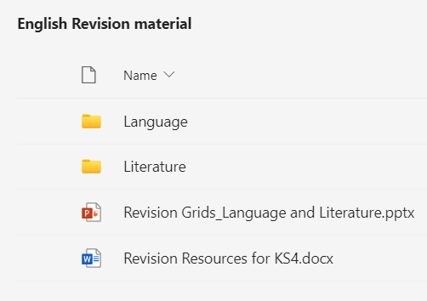
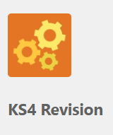
What support do students have to revise?

Slide 27
What support do students have to revise?
Past papers & mini-mocks = Y11 Revision folder on Teams
Online subscriptions: Seneca Learning, GCSE Pod, Massolit
Unit booklets & knowledge organisers
5-a-day Revision Guide (Literature)
CGP revision guides & flashcards (Literature)
Annotations in texts (Literature)
Writing and feedback in class books (e.g. PPEs & assessments)
Weekly lunchtime interventions & after-school revision lectures
Revision tasks set on EduLink
Additional essays & practice questions – teachers will mark

Slide 28
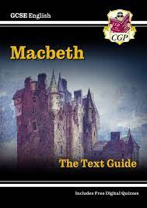
Grade 4+ = Knowledge Organisers & CGP Guides

Slide 29
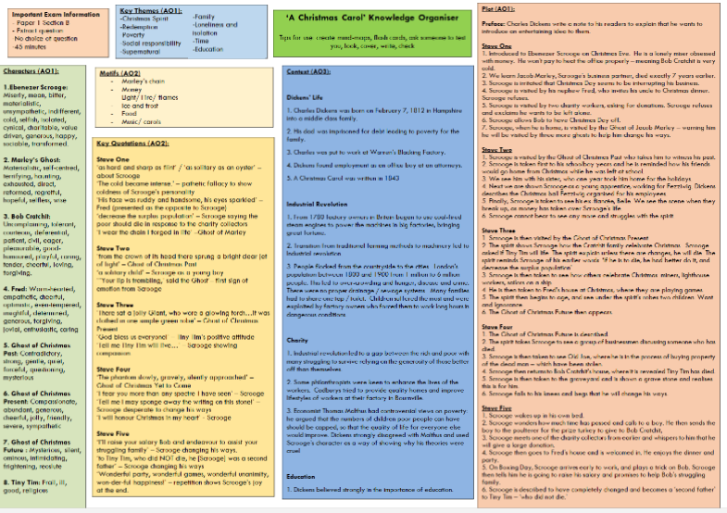
Grade 6+ = Knowledge Organisers, CGP Guides & Practice questions

Slide 30
Literature
Quotations about Macbeth’s character: 2 minutes | Quotations about Mrs Briling’s character: 2 minutes | How does Tennyson present conflict? 6-minute mini-plan
Masculinity in Macbeth: 3 minutes | Conflict in Macbeth: 3 minutes | ‘When you durst do it, then you were a man’ Write a paragraph about this quotation – remember to: analyse language, link to elsewhere in the play and use context 10 minutes
Words to describe violence: 2 minutes Angry Pain Unnecessary Inappropriate | Words to describe poverty: 2 minutes Unfair Struggle Poor Homeless

Slide 31
Grade 8+ = Massolit

Slide 32
Top tips!
Ask them to summarise the story of texts to you.
Ask them to explain each poem from the Poetry Anthology to you.
Make it into a game – a quick quiz with a little reward.
Use a timer – 15-20 minutes of genuine effort is better that 1 hour of unfocussed sitting.
Use the “in between” times – e.g. a short car journey, waiting for the kettle to boil.

Slide 33
Science Revision
EXAM INFORMATION

Slide 34
Science is a double or triple award subject
Combined Science (TRILOGY) have a series of 6 exams in total – 2 for each subject (each 1 hour 15 mins)
All the marks are COMBINED to give two GCSE grades.
These grades are always identical or consecutive
Eg 76; 66; 65; 55; etc
Triple Science (Biology, Chemistry and Physics) is treated as 3 separate exams – each consists of two 1 hour 45 min papers.
The two papers are added together to give one grade for each subject.
Because they are awarded separately students could get very different grades
Eg Biology 6; Chemistry 8; Physics 9

Slide 35
There are two tiers of entry
Higher paper – grades 99 – 44 (43 is allowed but anything below is classified as U)
Foundation paper – grades 55 – 11 (failure to reach the marks needed for 11 results in a U)
The papers are structured very differently:-
Higher – lots of unstructured, multi-mark answers
Foundation – guided answers (tick the boxes, fill in the missing words etc) and many single mark answers.
The higher paper also has additional material to learn.

Slide 36
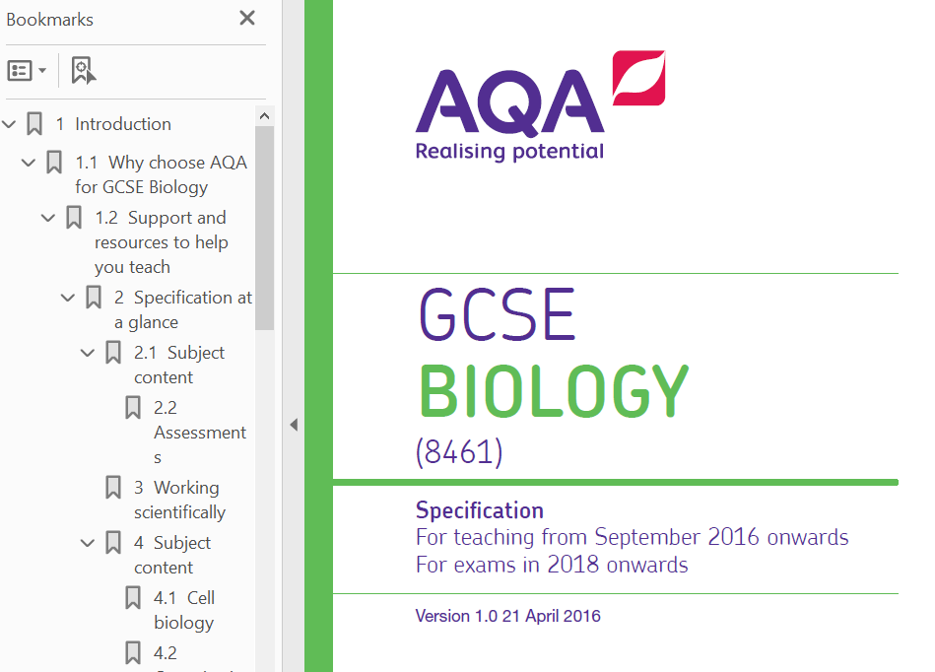
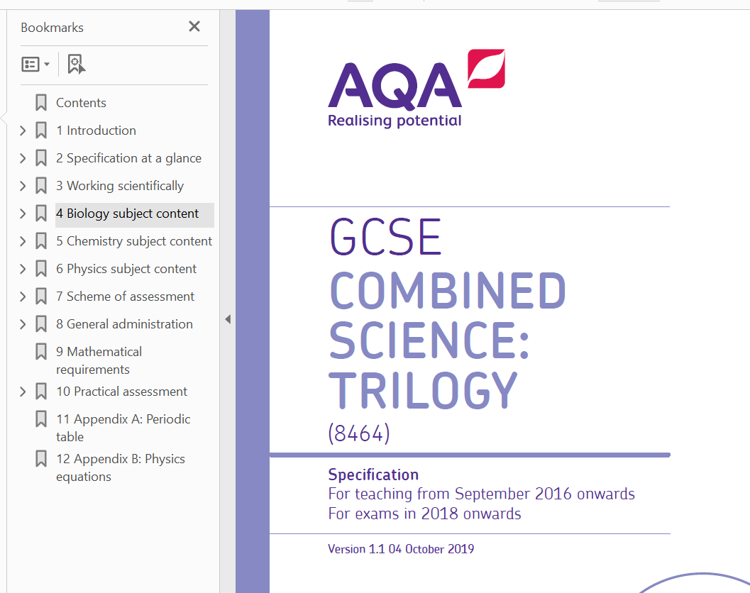
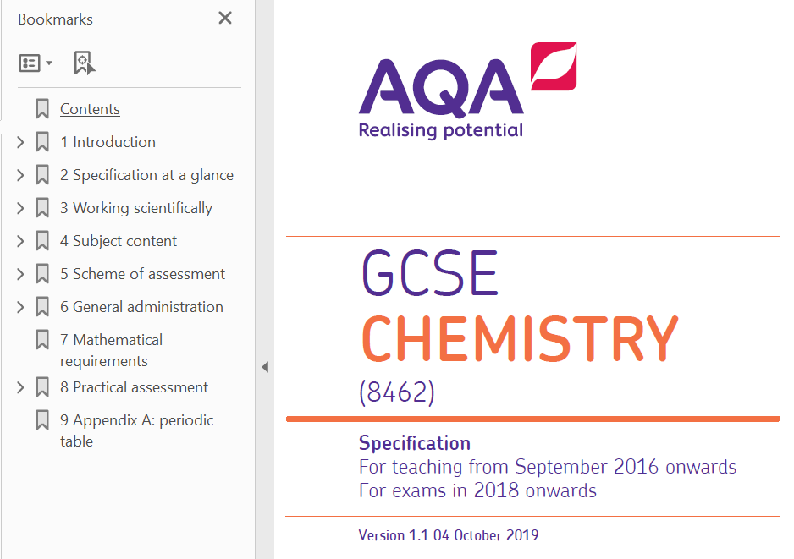
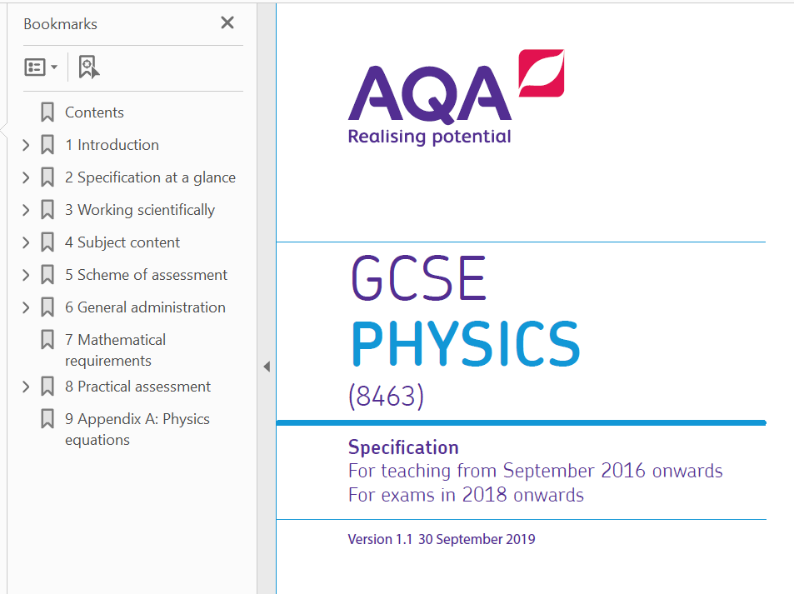
How do students know what they need to revise?
Exam Specifications

Slide 37
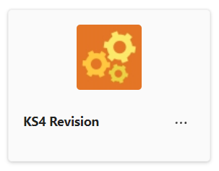
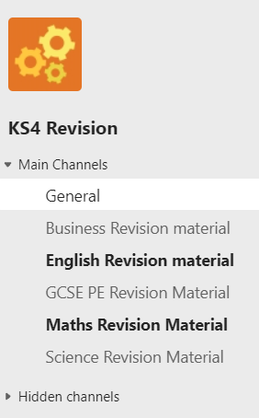
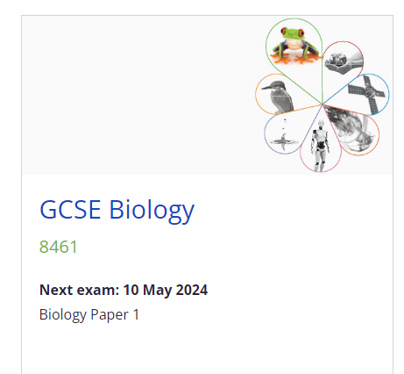
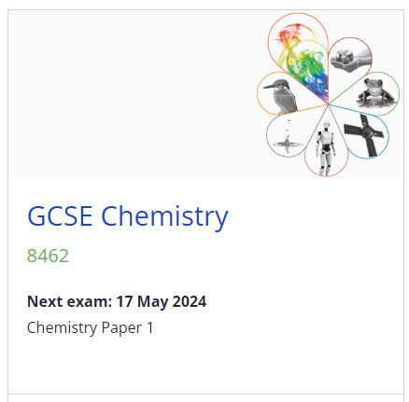
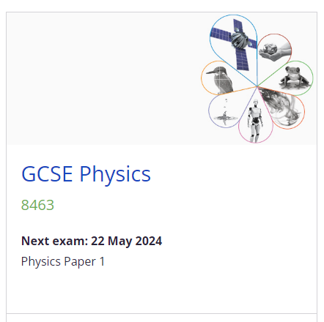
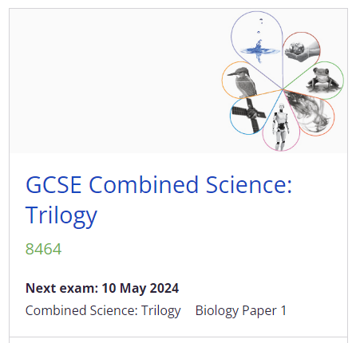
Exam Specifications are available online or on Teams
TEAMS
www.aqa.org.uk

Slide 38
The skills that are assessed in the exams
We have a number of REQUIRED PRACTICALS (21 in combined science)that students have done through the years that will be the basis of some questions.
About 15% of the marks come from knowledge, understanding and analysis of these required practicals.

Slide 39
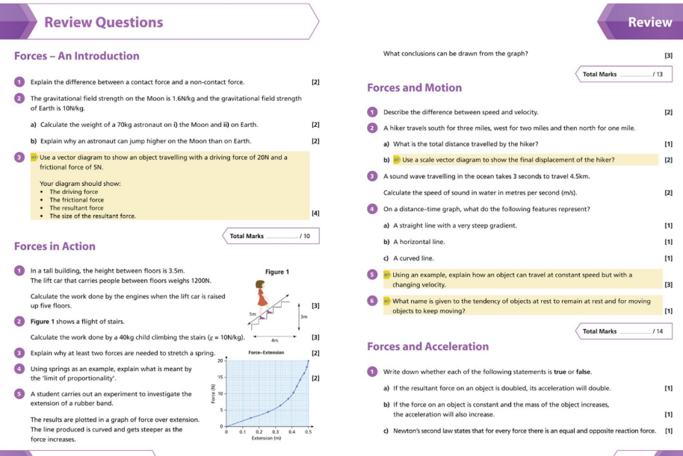
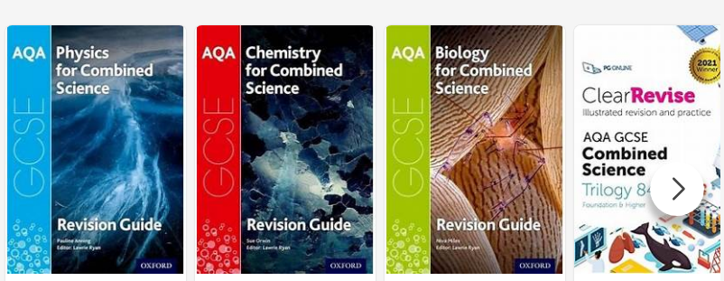
Revision Guides written for the course

Slide 40
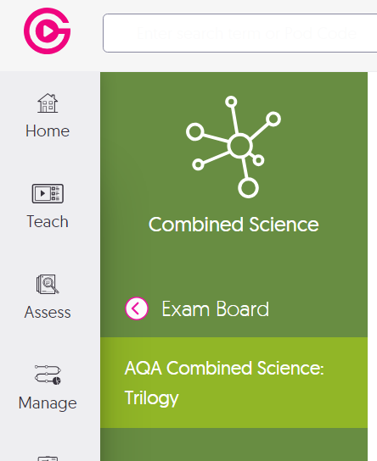
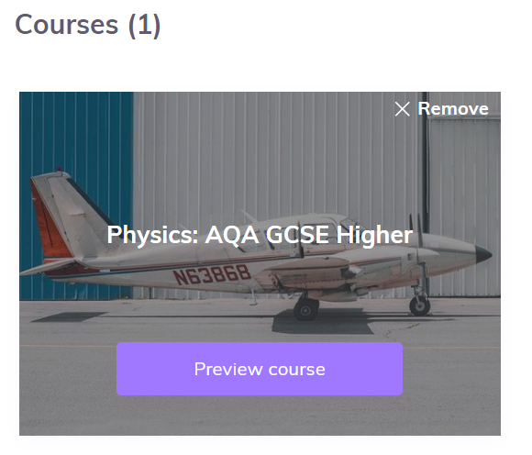
GCSEpod and Seneca Learning
Students have access to these via the school.
They should be able to sign up with their school log in details.

Slide 41
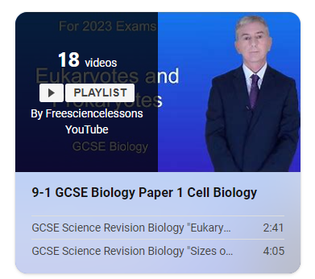
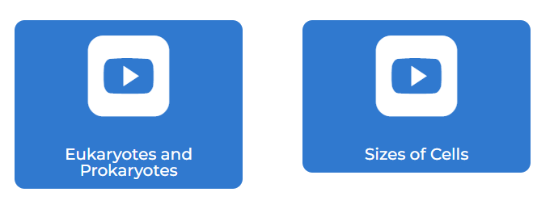
Revision Videos
FREE SCIENCE Lesson Videos

Slide 42
Cognito Science and Fuse School are also good but more generic
Primrose Kitten has AQA specific material

Slide 43
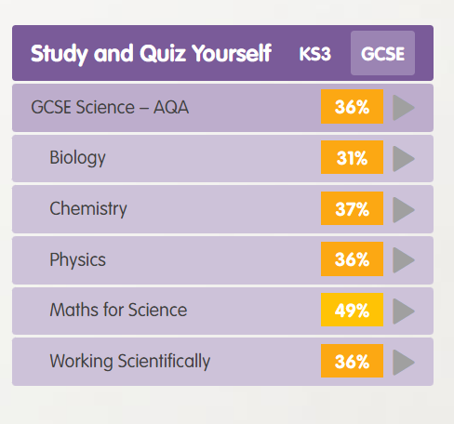
Other Resources
Do lots of practice answering questions.
Step 1 – use the Educake system for quick retrieval practice

Slide 44
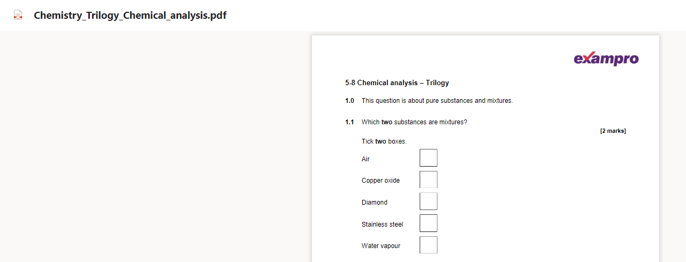
Step 2 – Do some end of topic questions from TEAMS.

Slide 45
Step 3 – PAST PAPERS!! All on TEAMS.
If there is no time for anything else this is the NUMBER ONE priority.
Students must complete them AND mark them.
The more they buy into this last step the easier they will fly in the exam itself.

Slide 46
Science Revision Sessions
Lunchtimes – rota sent to students and parents/carers about when, where and what will be revised. These will be focusing on AO1 – knowledge and understanding and AO2 - application
Afterschool sessions. These will be focusing on AO2 and 3 – the generic skills that are assessed every year – maths skills, how to answer longer answers, how to analyse, compare and justify etc. Each week will be a different set of skills with a focus on exam techniques.

Slide 47
Intervention
Feb half term revision
Easter revision
May half Term revision
Some lectures will take place
Intervention timetable shared with all students

Slide 48
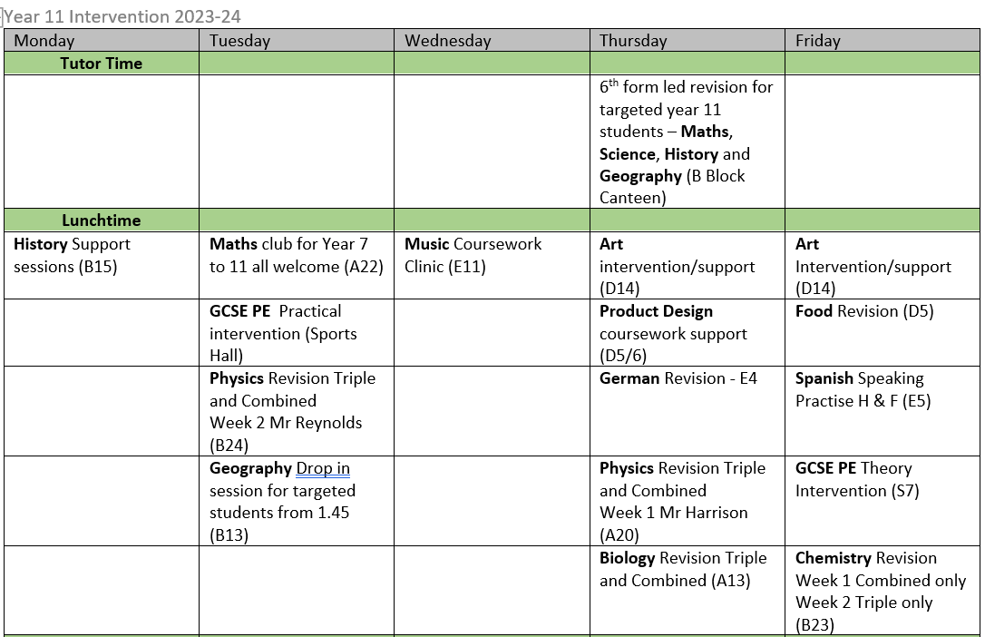
Guilsborough Academy - Intervention Timetables

Slide 49
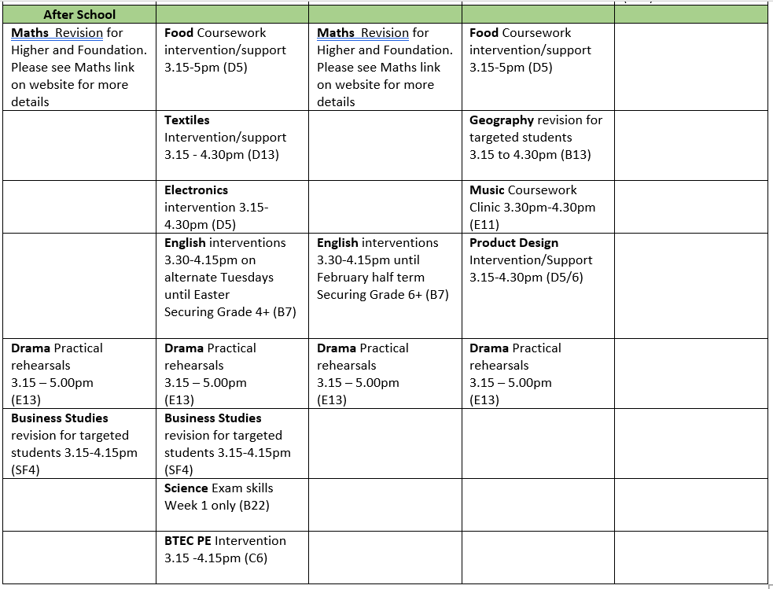

Slide 50
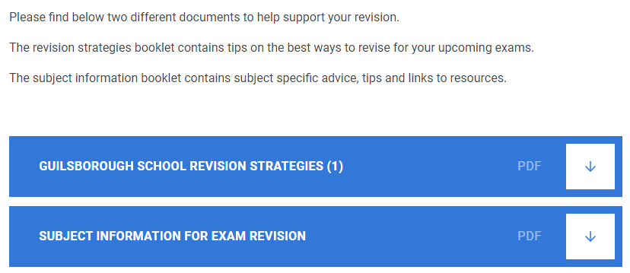
Revision Strategies
Guilsborough Academy - Exam Resources
KS4 Revision | General | Microsoft Teams
Students also have access to a TEAMS channel where revision materials for all subjects have been collated

Slide 51
Not long to go
There are 59 school days until the first exam
Less than 2 months of school
21 days of holiday (excl weekends) to revise

