Slide 1
Year 12 Bridging Work- Summer 2026
Which city is managing urban challenges more effectively?
You are to create a project comparing different aspects of London and Rio De Janeiro. You must include:
Cause of urbanisation
Impacts of urbanisation
Urban policy changes
Exogenous and endogenous factors
Waste management
Pollution issues & management
Dereliction & regeneration
Sustainability strategies
Final Judgement
More information, guidance and examples can be found on the PowerPoint slides!!!

Slide 2

Year 12 Bridging work
Which city is managing urban challenges more effectively?

Slide 3

AGENDA
Urbanisation: Causes & Impacts
Create a table or bullet points for each city:
When major urbanisation happened
Why people moved there (push/pull factors)
Key industries that encouraged growth
Impacts- Social, Economic and Environmental

Slide 4
Endogenous & Exogenous Factors
Explain the difference briefly. Then include examples for each city:
Endogenous (internal):
Location
Infrastructure
Local industries
Exogenous (external):
Globalisation
Foreign investment
Migration
International events

Slide 5
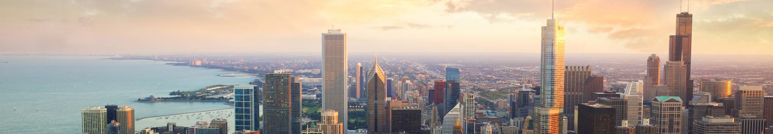
Urban Policy Changes (London)
Choose two policies. For each:
What problem it aimed to solve
Who benefited
Any disadvantages
How successful it was
Examples:
Congestion Charge
ULEZ
Docklands regeneration

Slide 6

Urban Policy Changes (Rio)
Choose two policies. For each:
What problem it aimed to solve
Who benefited
Any disadvantages
How successful it was
Examples:
Favela pacification (UPP)
Olympic regeneration
BRT transport corridors

Slide 7
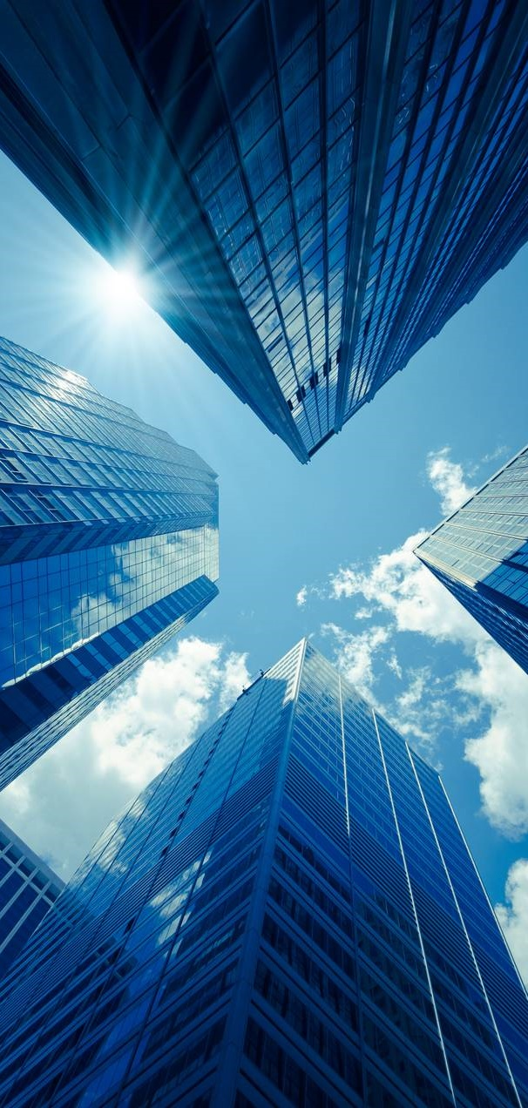
Waste Management
For each city:
How waste is collected
How much is recycled (if you find data)
Main challenges
One strength and one weakness

Slide 8
Pollution Issues
Use two columns: London and Rio Include:
Main pollution types (air, water, land)
Causes
Impacts on people/environment
Pollution Management
For each city:
Strategies used to reduce pollution
How effective they are
Any improvements still needed

Slide 9

Dereliction & Regeneration
Choose one regeneration example per city:
What caused dereliction
What regeneration involved
Who benefited
Any criticisms
Examples:
London: Docklands, Stratford, King’s Cross
Rio: Porto Maravilha, favela upgrading

Slide 10
Sustainability Strategies
List three strategies per city.
Examples:
Green transport
Urban greening
Renewable energy
Favela upgrading
Reforestation

Slide 11
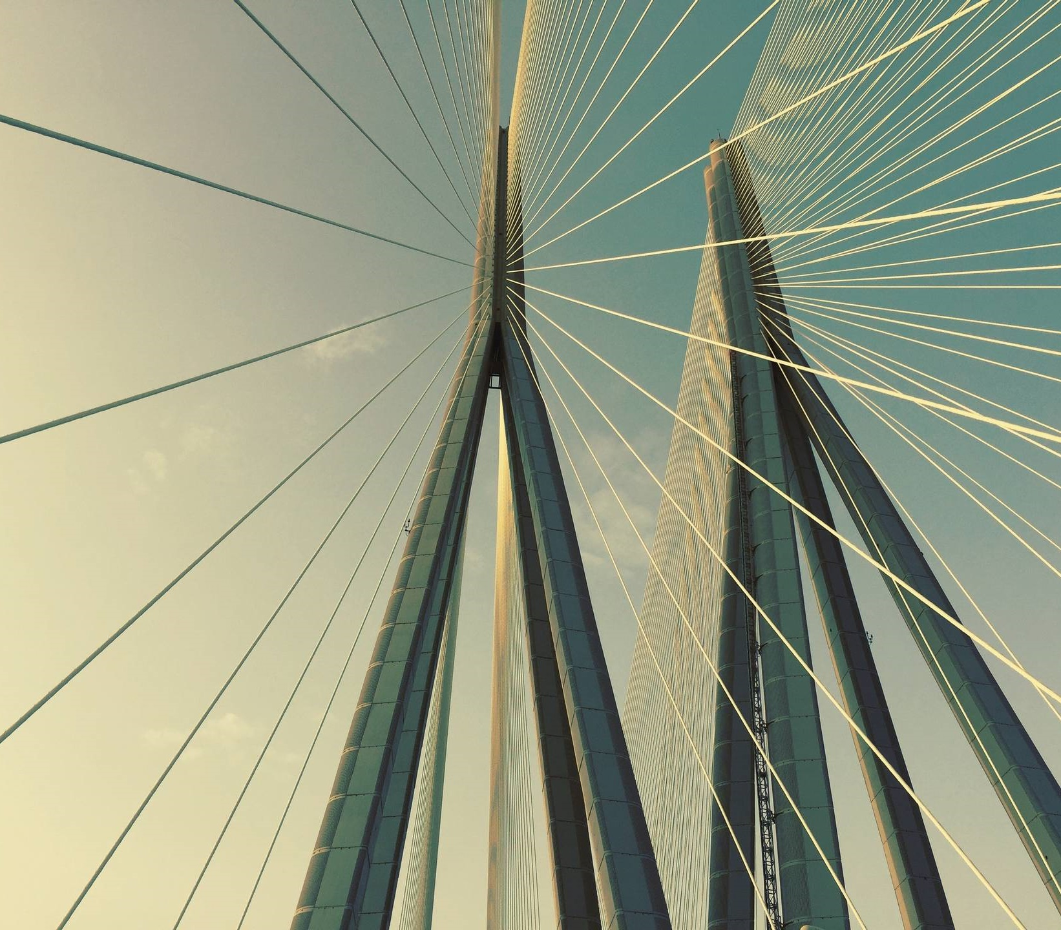
Final Judgement
Answer the big question: Which city is managing urban challenges more effectively, and why? Give 2–3 clear reasons.

